Slide 1

Inferential Statistics

Slide 2
INTRODUCTION
Statistical Analysis
Advantages
Random variables and Probability
Probability Distributions
P-Values
Hypothesis Tests
Applications
Types of tests
Single Sample
Two Sample
Multiple Sample
Non Parametric Tests
© Jigsaw Academy Education Pvt. Ltd.

Slide 3
Summary statistics
Why is it important for us to learn about summary statistics?
Description of a large number of data points
Generate inferences from the summary statistics
A very simple example
You work for a credit card company, and you have data on credit card applications. You divide the data into applications from customers who have a great payment record, and applications from customers who have been late with payments at least 3 times in the last year
Average salary for Group 1: $37,000. Standard Deviation: $5,000
Average Salary for Group 2: $26,000. Standard Deviation: $9,000
© Jigsaw Academy Education Pvt. Ltd.

Slide 4
Summary statistics
Going beyond summary statistics
With large volumes of data :
Many trends
Multiple patterns
Some contradictory findings
How do we establish
Meaningful trends vs random “noise”
Relative importance or impact?
Inferential Statistics
Allows us to find statistically significant relationships
Remove noise

Slide 5
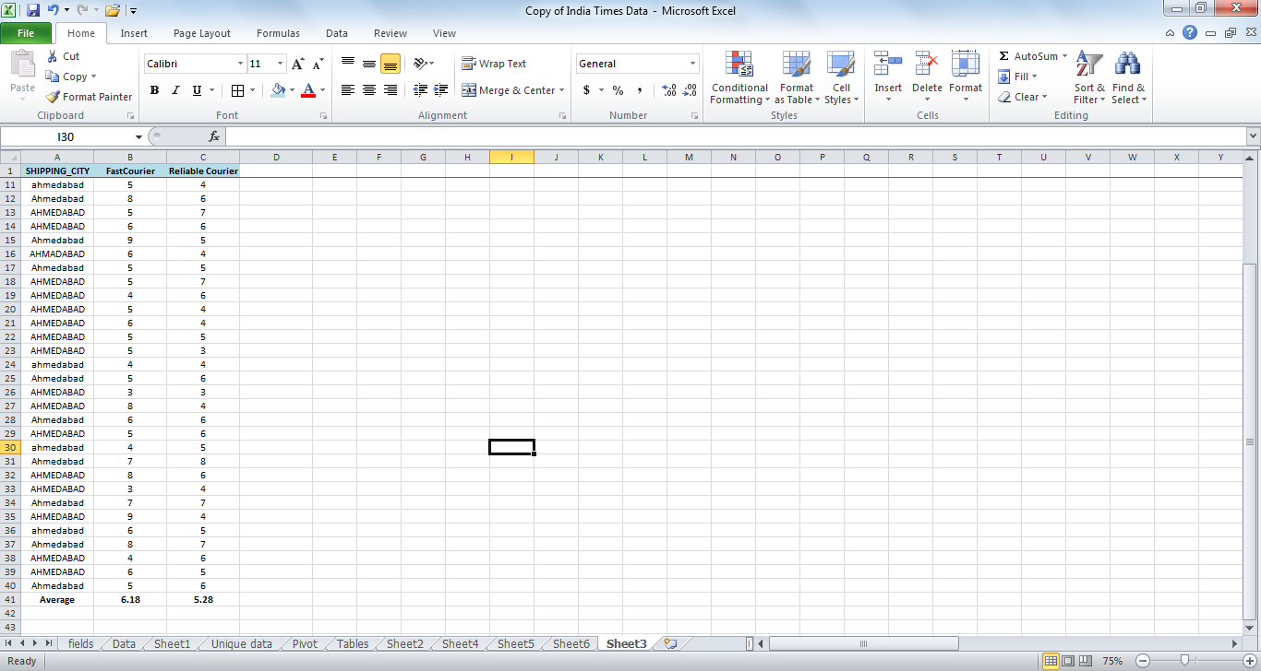
CASE STUDY
You receive customer complaints about a courier vendor you use for delivery of products purchased – they do not seem to be delivering on time.
You confront the vendor and they claim that they meet industry standards, and that the complaints are a result of isolated and one-off situations
You compare the delivery times for random (39) transactions to the same city between this vendor (FastCourier) and your most reliable courier vendor (ReliableCourier)

Slide 6
Case study
Is 6.18 different from 5.28?
Is it a big difference?
What would you conclude?
Absolute difference: 0.90 days
% Diff (relative to Reliable): 16%
Should we take another sample?
Is this the population?
Is sample size an issue?

Slide 7
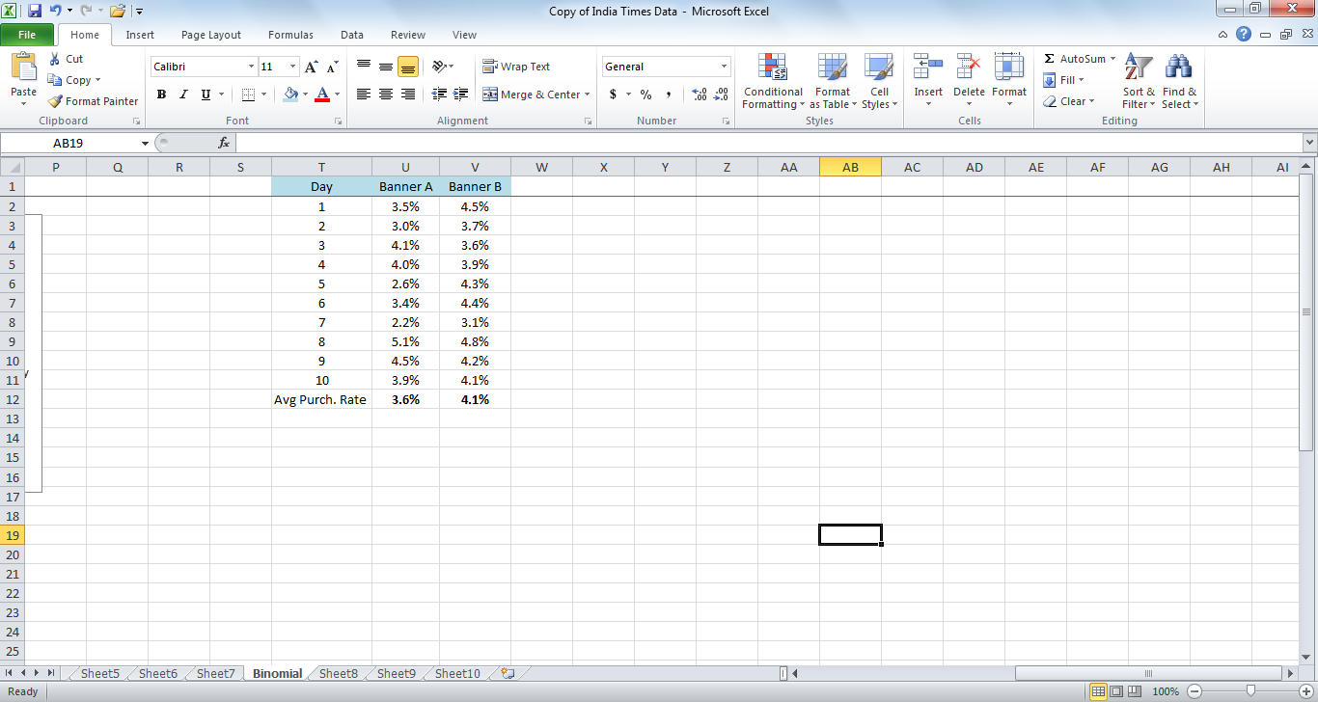
CASE STUDY 2 A/B TESTING
You are testing banner ads on your ecommerce website, with changes in copy.
You run with one type of banner for 10 days, and check key KPIs (say purchase rate).
You then run second banner for next 10 days and check purchase rate
This is the data, on a daily basis.
Is Banner B better? How confident are you?

Slide 8
Sample VS population
In the previous slide, we have introduced the concept of sample and population
Examples of Populations
All applications received for credit cards from Bank XYZ
All consumers of Product Y
What others can you think of?
Examples of Samples:
All applications received in the last 3 months
Women consumers over the age of 45 that have bough Product Y in the last 6 months
What else?
© Jigsaw Academy Education Pvt. Ltd.

Slide 9
Sample vs population
Why do we need to separate the two?
Population (or the Universe) tends to be very large, making it difficult (or impossible) to collect and analyze data on the population
It is easier to take a subset of the population, analyze the subset, and then make inferences about the population
The second point depends on a fundamental assumption – what is that?
Representativeness
We have to find a sample that is representative of the population that it belongs to
© Jigsaw Academy Education Pvt. Ltd.

Slide 10
Sample vs population
Let’s say we have a population of 10000 respondents to a survey, and we want to take a sample of 500. How many samples are possible?
Clearly, we can choose many samples from a population. A good sample is that which is chosen:
Without bias :(not choosing only high income respondents)
Full coverage: All segments in population are correctly represented
Nonresponse inclusive: If 20% of your population are defaulters, your sample ideally should also have 20% defaulters
© Jigsaw Academy Education Pvt. Ltd.
Notes:
The representativeness of a sample is critical to statistical inferences. If your sample does not represent a population, then any inference you make is pretty much invalid for the larger population.
If in your population men to women ratio is 60 to 40, your sample ratio should also be 60 to 40. If High income to Low income ratio is 25 to 75, again, in your sample, you want that ratio to be preserved.

Slide 11
How to choose a sample
So how do we select a sample?
Simple random sample :
All members in a population have an equal chance of being selected in the sample
Stratified random sampling:
Population members are first divided into groups or strata based on meaningfulness. Then random samples are taken from each strata
The important thing to remember while building a sample is representativeness. We assume that the sample represents the population, so any inferences we draw about the sample will be true of the population
© Jigsaw Academy Education Pvt. Ltd.
Notes:
Sampling theory is a vast subject that studies the different types in which samples can be created that are “random” and without bias.
Remember that a large sample does not always mean a good sample. Also remember that there are a minimum number of observations you need in a sample to make it representative. So very small sample sizes are not good for drawing inferences about a population. A general rule of thumb is at least 30

Slide 12
Case study
You work for Airline X as GM Sales. For any flight, let’s assume for simplicity that there are always 100 seats. When selling flight tickets, you could always sell exactly 100 tickets. However, you know that in most flights, some people will not show up, so you could maximize sales by reselling that ticket.
How do you decide how many tickets you should oversell for each flight?
Remember, if you oversell by more than the number of people who don’t show, you will lose money in terms of putting those people on other flights plus some compensation
© Jigsaw Academy Education Pvt. Ltd.

Slide 13
Random variables and probability
We introduce the concept of random variables and how they apply to statistical theory
A random variable is one that takes a numerical value whose outcome is determined by an experiment.
Time spent by a visitor on your website
Purchase by a visitor via your website
Delivery of shipment by a courier company
© Jigsaw Academy Education Pvt. Ltd.
Notes:
How would you define experiment in the airline case listed? Do not take experiment literally

Slide 14

Another example
Fast Courier Delivery Times:
Random variable?
Remember: its not random in the sense that you have zero knowledge
Range of possible outcomes?
Probability of each possible outcome?

Slide 15
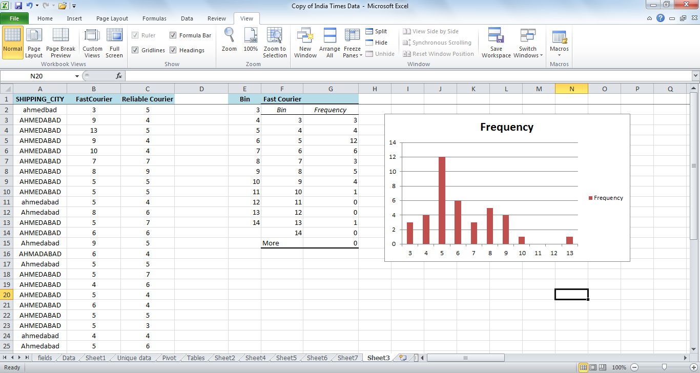
Probability distribution
Fast Courier:
In sample of 39 observations
What is probability of a random delivery taking 8 days?
8 days or more?

Slide 16
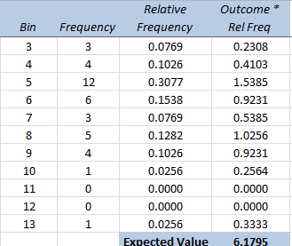
Expected value of a random variable
The Expected Value is the sum of product of each outcome value with the probability of that outcome
© Jigsaw Academy Education Pvt. Ltd.
Notes:
What does 5.14 mean? It means that if we flip a coin 10 times, on average we expect to see about 5 heads. Remember that this is made up data so 5.14 really does not mean much. But it is very important to understand exactly what we are talking about.
When we run the experiment the first time, it is possible to see 0 heads, or 1 head, or 2 heads etc all the way to 10 heads. We have no way of knowing upfront what that number is (assuming you have not biased the coin in any way). But, if we run the experiment, note the number of heads, re-run, note it again and repeat multiple times, you will notice that it is more probable to get 4 or 5 or 6 heads in a 10 flip than it is to get only 1 head or all 10 heads.
The expected value therefore denotes an expectation of average across a distribution of random variables
The mean (or expected value) of X gives the value that we would expect to observe on average in a large number of repetitions of the experiment

Slide 17
Expected VALUES
Problem: A term life insurance policy will pay a beneficiary a certain sum of money upon the death of the policy holder. These policies have premiums that must be paid annually.
Suppose a life insurance company sells a $250,000 one-year term life insurance policy to an 18-year-old male for $350. According to the National Vital Statistics Report, Vol. 47, No. 28, the probability the male will survive the year is 0.998789. Compute the expected value of this policy to the insurance company.

Slide 18
Probability distribution
A probability distribution therefore includes all possible outcomes of an experiment repeated n times
A discrete probability distribution is a list of discrete outcomes ,
and a continuous distribution is a product of an experiment with continuous possible outcomes
© Jigsaw Academy Education Pvt. Ltd.

Slide 19
Discrete probability distribution function: binomial distribution
The Binomial Distribution is an example of a probability distribution of a discrete random variable
The coin toss example is most widely used, but there are many other examples:
Gender of babies delivered in a hospital
Fatal side effect deaths for a Schedule H drug
The common feature across all these examples is:
1. There are only two possible outcomes: Win or Lose, 1 or 0, Male or Female
2. There are no external factors influencing the probability of each outcome over time
3. The chances of each outcome are independent of previous results
© Jigsaw Academy Education Pvt. Ltd.

Slide 20

Discrete probability distribution function: binomial distribution
You are the Finance Manager for Company X, and you are looking at your AR balances. Based on past data, you know that on average 40% of your customers are more than 60 days late with payments
Let’s say you have a total of 5 customers, and you want to create a contingency for situations where > 50% of your customers are late
Probability of 0 customer being late?
Overall probability of being late (p): 0.4
Probability of not being late (1-p): 0.6
Total number of trials (n) : 5
Total successes (x); 0
If you calculate this you will get: 0.0776
© Jigsaw Academy Education Pvt. Ltd.

Slide 21
Discrete probability distribution function: binomial distribution
If you recalculate for 1 late customer out of 5:
p = 0.2592
2 Late customers:
P = 0.3456
3 late customers:
P = 0.2304
4 late customers:
P = 0.0768
5 late customers:
P = 0.0120
So p of > 50% customers being late = 0.2304 +0.0768 +0.0120 = 0.3192
© Jigsaw Academy Education Pvt. Ltd.

Slide 22
Discrete probability distribution function: binomial distribution
Things to note:
Irrespective of the actual experiment, as long as number of trials are 5 and probability of success is 0.4, p =0 is always 0.0776
If probability of success is 0.4, it makes intuitive sense that probability of success = 0 is a low number relative to probability of success, as is probability of success = 5
We can calculate the probabilities for a family of binomials, where n = 5 but p changes from 0.1 to 0.9
We can also calculate probabilities for any n and success combination, and these will be fixed values
© Jigsaw Academy Education Pvt. Ltd.

Slide 23
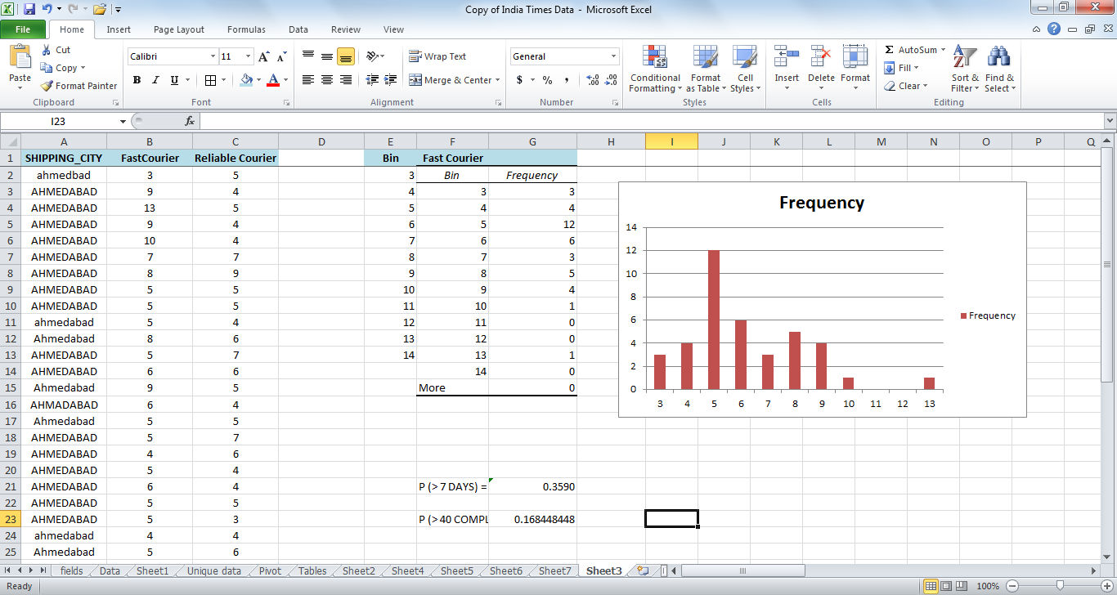
Discrete probability distribution function: binomial distribution
FastCourier:
If greater than 7 days = “LATE”;
P(LATE) = ?
What is the probability that you will see a greater than 40% complaint rate?
Can calculate this easily in Excel using a statistical function

Slide 24
EXCEL STATISTICAL FUNCTIONS
Formulae for calculating probabilities of random variable outcomes:
If we know that distribution of the outcomes of the random variable, we can calculate probabilities of any specified outcome
Binomial Distribution – Excel Function
= BINOM.DIST(No of successes, No of trials, Prob. Of success, Cumulative Prob)
For the prev. example:
P (exactly 40% complaint rate in a sample of 100) = Binom.dist(40,100,0.3590,false)

Slide 25
EXCEL STATISTICAL FUNCTIONS
What if cumulative = TRUE?
It generates p ( < = 40)
That is: p(0 late) + p(1 late) +… p(40 late)
What about p (> 40)?

Slide 26
BINOMIAL DISTRIBUTION
1. An oil exploration firm plans to drill 6 holes. They believe that the probability that each hole will yield oil is 0.10. Since they will be drilling in different locations, the outcomes are statistically independent.
If the firm needs two or more holes to produce oil to stay in business, what is the probability that they will stay in business?
2. An XYZ cell phone is made from 55 components. Each component has a .002 probability of being defective. What is the probability that an XYZ cell phone will not work perfectly?
3. Suppose that 48% of individuals 85 years and older have Alzheimer’s Disease. You go to a nursing home that has been feeding residents a diet consisting of natural, organic, and healthy foods including free range chickens, omega 3 eggs, flax seed, etc. You find that only 29 of 100 residents who are 85-years and older have Alzheimer’s disease? What is the likelihood of this outcome?

Slide 27
Poisson distribution
Another discrete probability distribution, that is used to model number of events occurring in a time frame
Examples include:
Number of insurance claims in a month
Disease spread in a day
Number of telephone calls in an hour
Number of patients needing emergency services in a day
The following conditions apply to correctly use a Poisson Distribution:
Events have to be counted as whole numbers
Events are independent: so if one event occurs, it does not impact the chances of the second event occurring
Avg frequency of occurrence for the given time period is known
Number of events that have already occurred can be counted
© Jigsaw Academy Education Pvt. Ltd.

Slide 28
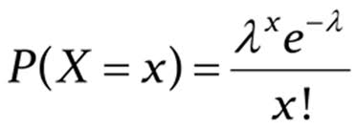
Poisson distribution
Poisson Probabilities are calculated as:
Where, Lambda is the mean number of occurrences in a given interval of time .
Notice here that there is no n (sample size) impact
Similar to how the Binomial probabilities are calculated, for every X and Lambda we can calculate the Poisson Probabilities
In Excel: POISSON.DIST(X,MEAN, CUMULATIVE)
© Jigsaw Academy Education Pvt. Ltd.

Slide 29
Poisson distribution GROUP CASE STUDY
CAPACITY PLANNING:
You need 4 resources to process orders via your web-site daily. Currently you receive an average of 392 transactions a day. Maximum transactions per person per resource is 101. Your website cannot handle > 450 transactions in one day.
Avg transaction size is Rs.950. Should you invest in an additional resource at a cost of Rs 300 per day?
© Jigsaw Academy Education Pvt. Ltd.

Slide 30
Continuous probability distributions
Continuous distributions are applicable when an event can take on any value within a given range
Examples include:
Height of males in Bangalore
Average waiting time per patient at a hospital
Per Capita Income
The most common kind of a continuous probability distribution is the Normal Distribution, on which we will spend some time because of its useful applications in statistics
© Jigsaw Academy Education Pvt. Ltd.

Slide 31
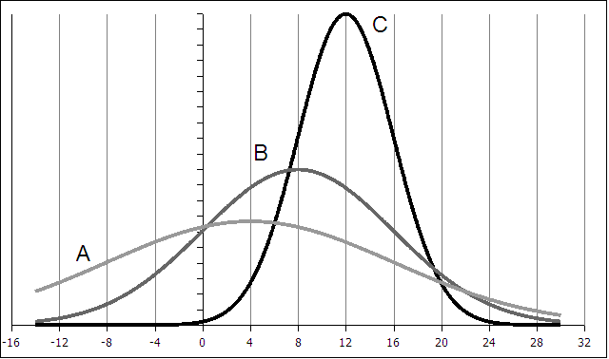
Normal probability distribution
Symmetric about the (single) mean
Mean = Median = Mode
The two tails extend indefinitely and never touch the axis
What are the differences between the curves?
© Jigsaw Academy Education Pvt. Ltd.

Slide 32
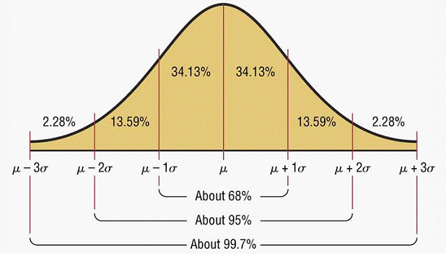
NORMAL DISTRIBUTION
Notes:
For a normal distribution or a bell shaped curve like the one on the slide, 68% of values lie within 1 std deviation of the mean.
About 95% lie within 2 std deviations from the mean
About 99% lie within 3 std deviations.
For any distribution, regardless of the shape, at least 75% of the values lie within +/- 2 std deviations of mean and 89% within +/- 3 std deviations.

Slide 33
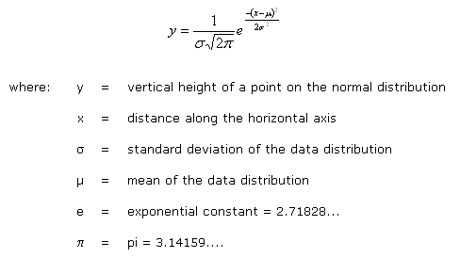
Normal probability distribution
http://www.pavementinteractive.org/index.php?title=Normal_Distribution
© Jigsaw Academy Education Pvt. Ltd.

Slide 34
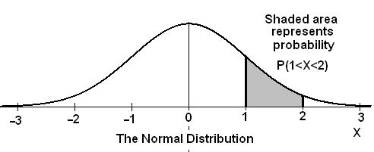
Normal distribution
Area under the curve:
The total area under a normal probability curve is always 1 . This property allows us to think of the area as probability, and therefore we can compute probability two values on the curve
© Jigsaw Academy Education Pvt. Ltd.
Notes:
When we were dealing with discrete probability distributions each value of x was related to a specific probability. In continuous probability distributions we can't point to specific values of x with spaces between the x values. The values of x all flow together. Thus when we discussed the Empirical Rule we talked about 68% of the data being between the mean plus one standard deviation and the mean minus one standard deviation (mean +s and mean-s). When dealing with with continuous distributions, and in our case it will usually be the normal distribution (pictured below) we will talk about the probability that x will be between certain values.
For continuous distributions the probability that the variable will fall between two values is the area under the curve between those values.
The normal distribution is a continuous probability distribution. This has several implications for probability.
The total area under the normal curve is equal to 1.
The probability that a normal random variable X equals any particular value is 0.
The probability that X is greater than a equals the area under the normal curve bounded by aand plus infinity (as indicated by the non-shaded area in the figure below).
The probability that X is less than a equals the area under the normal curve bounded by a and minus infinity (as indicated by the shaded area in the figure below).
Additionally, every normal curve (regardless of its mean or standard deviation) conforms to the following "rule".
About 68% of the area under the curve falls within 1 standard deviation of the mean.
About 95% of the area under the curve falls within 2 standard deviations of the mean.
About 99.7% of the area under the curve falls within 3 standard deviations of the mean.
Collectively, these points are known as the empirical rule or the 68-95-99.7 rule. Clearly, given a normal distribution, most outcomes will be within 3 standard deviations of the mean.

Slide 35
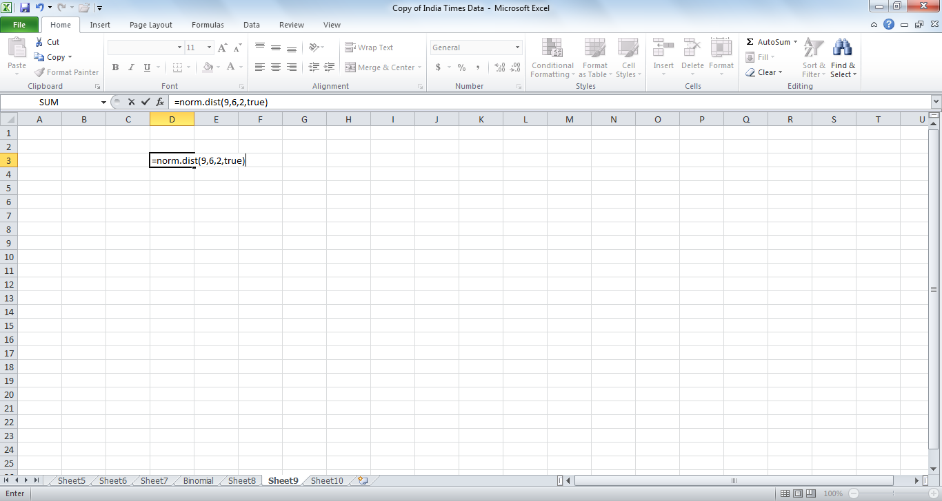
Normal distribution
We can calculate probabilities of any X given mean and std deviation
If total delivery time is normally distributed with a mean of 6 days and a std deviation of two days, what is the probability that a random delivery takes greater than 9 days?
Use Excel:
Formula: NORM.DIST(Outcome x, Mean, Std Dev, cumulative)= NORM.DIST(9,6,2,?)
Is this the right answer?
© Jigsaw Academy Education Pvt. Ltd.
Notes:
You can c

Slide 36
Normal distribution
Probability that a random delivery will take between 6 and 8 days?
Delivery will take less than 4 days?
So finally, where is all this leading? To Hypothesis Testing (A/B Testing)

Slide 37
Central limit theorem
We will introduce one important concept here that will aid us in calculating
the probability or chance: the Central Limit Theorem
Supposing we have a population of 10,000 respondents to a survey, and we wish to pick a sample of 500
How many samples are possible?
What will be the mean of the samples? Same? Different?
If we plot a frequency distribution of the sample means – Excel simulation
© Jigsaw Academy Education Pvt. Ltd.
Notes:
The concept of a sampling distribution, allows us to determine the probability that the particular sample obtained will be unrepresentative.
On the basis of sample information, we can make inference about the parent population.
Sampling Error.
No sample will have the exact same mean and standard deviation as the population
Sampling distribution of the mean
In research sampling error is often unknown since we do not have the population parameters
A distribution of means of several different samples of our population
Less widely distributed than the population
Usually Normal
Central Limit Theorem:
If a random sample of n observations is selected from a population (any population), then when n is sufficiently large, the sampling distribution of x will be approximately normal.
(The larger the sample size, the better will be the normal approximation to the sampling distribution of x.)

Slide 38
Central limit theorem
Central Limit Theorem:
As sample size grows sufficiently large, the sampling distribution of
the means will tend towards a normal distribution (even if the underlying
population is not normal)
Mathematically:
When we select simple random samples of size n, the distribution of these sample
can be modeled means with a probability model that is
Implications : If sample size is sufficiently large (> 30), you can always use a
normal distribution as your test distribution without worrying about true
population distribution

Slide 39
Hypothesis testing
Inventory Optimization
You want to optimize inventory costs , and you are reviewing mobile electronic equipment. You have been using a daily sales average for this category as 310, with a std deviation of 85 (based on past data a year ago). You take a current sample of the last 45 days to validate, and find that avg daily sales are 338. Should you increase inventory levels?
SIMPLE ANSWERS?
Yes, data clearly shows increase in inventory levels.
No – we need a larger sample before we decide
© Jigsaw Academy Education Pvt. Ltd.

Slide 40
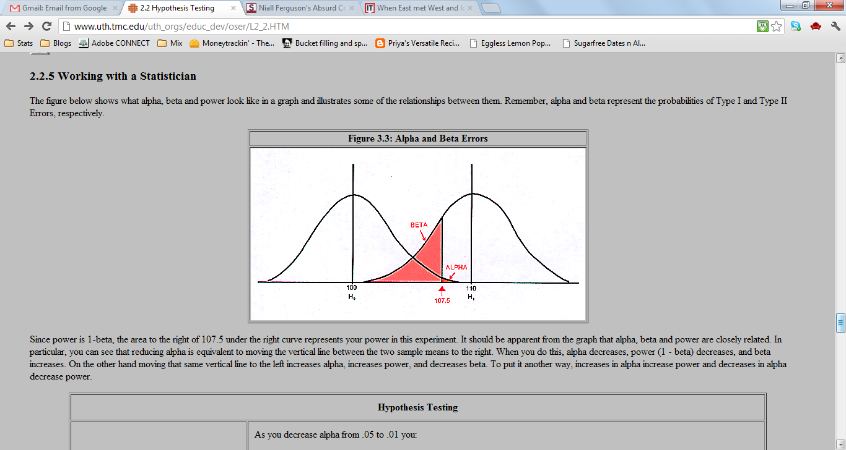
Hypothesis testing
One way to solve this is to run a hypothesis test.
1. Set up NULL HYPOTHESIS
There is no increase in daily rate, observed differences are simply random chance variation
2. Set up ALTERNATE HYPOTHESIS:
Negation of Null: There is an increase in daily sales rate
3. Calculate Probability of observed outcome

Slide 41
Hypothesis testing
Probability of Observed Outcome?
Use Central Limit Theorem.
This sample is one of multiple possible samples from the population of customers,
and therefore means of all possible samples will follow a normal distribution
Given a normal distribution, we can compute probability of an observed outcome.
= NORM.DIST(338,315,85/(45^0.5),TRUE)

Slide 42
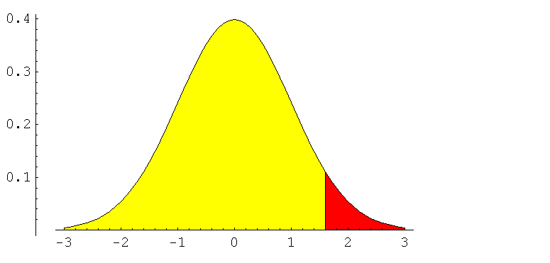
Hypothesis testing
= NORM.DIST(338,315,85/(45^0.5),TRUE)
What will this generate?
We need probability of outcomes as extreme or more extreme assuming that the null is true
That is:
1 – norm.dist(338,315,85/(45^0.5),true)

Slide 43
Hypothesis testing
What if the observed probability was low?
What if the observed probability was high?
How do we decide the separation between low and high?
Low? Or High?
20%

Slide 44
Hypothesis testing
Cut-off : SIGNIFICANCE LEVEL (ALPHA, α )
Calculated Probability: P-VALUE
IF:
P-VALUE < SIGNIFICANCE LEVEL
REJECT THE NULL HYPOTHESIS
P-VALUE > SIGNIFICANCE LEVEL
FAIL TO REJECT THE NULL HYPOTHESIS
α

Slide 45
Hypothesis testing
Significance Level usually 5%
In the inventory example:
Null Hypothesis: Daily Sales rate has not changed
Alternate Hypothesis: Daily Sales Rate has increased
Significance Level: 5%
P-Value : 1 – NORM.DIST(338,315,85,TRUE) = 0.013
Conclusion?

Slide 46
Hypothesis testing
You believe that average discounts on books is maintained around 24%. You take a random sample of 100 books and find that average discount is 26%, with a std deviation of 6%. Is this a substantial difference? Are your books discounted more than expected?
NULL HYPOTHESIS:
Discounts are still averaging 24%
ALTERNATE HYPOTHESIS:
Discounts are steeper than 24%
SIGNIFICANCE LEVEL:
10%
P –VALUE:
= 1- norm.dist(27,24, 6/10, true) = 0.0004
CONCLUSION?
Notice used Sample std deviation instead of pop. std dev

Slide 47
Hypothesis testing
Types of Hypothesis Tests:
1. One Tail and Two Tail Tests
2. Large Sample (Z Tests) and Small Sample Tests (T Tests)
3. One sample and Two Sample Tests
Single Sample Z/T tests, Independent Sample T tests, Paired Sample T tests
4. Multiple sample tests
ANOVA
5. Non-parametric Tests
Chi Square Tests

Slide 48
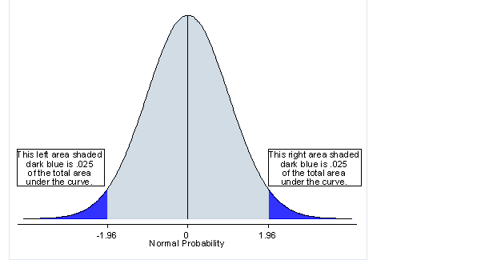
Hypothesis testing
If Alternate Hypothesis is set up as:
Sample mean not equal to population mean:
Two Tail Test
P-VALUE should be compared to SIGNIFICANCE LEVEL/2

Slide 49
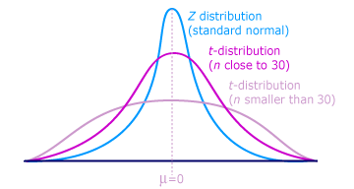
Hypothesis testing
Large Sample and Small Sample Tests
Is sample size > 30 – Use CLT and Normal Distribution
Sample Size < 30 – Use T Distribution
Suppose we have a simple random sample of size n
drawn from a Normal population with mean µ and
standard deviation sigma.
has a t distribution with n-1 degrees of freedom

Slide 50
HYPOTHESIS TESTING T - TESTS
If sample size is < 30, your data may not be normally distributed.
In order to compute probability of an observed outcome when sample size < 30, use a t- distribution or a t-test
Suppose we have a simple random sample of size n drawn from a Normal population with
mean µ and standard deviation sigma.
has a t distribution with n-1 degrees of freedom
As sample size increases and approaches 30, the t-dist
approximates a normal distribution
© Jigsaw Academy Education Pvt. Ltd.

Slide 51
HYPOTHESIS TESTING T - TESTS
You believe books are your most popular category of sales, with a 35% share of transactions. A random sample of 10 days shows books share of total daily sales averaging 32%, std deviation 3%. Has share of books reduced? Use a 5% level of significance
NULL HYPOTHESIS
Share of books category = 35%
ALTERNATE HYPOTHESIS
Share of books category not equal to 35% (TWO TAIL TEST)
SIGNIFICANCE LEVEL: 5%
P-VALUE: Calculate T stat, and use Excel
T = (32 -35)/(3/(10^0.5)) = -3.16
Excel: = T.DIST(X, deg_freedom, cumulative) = T.DIST(-3.16, 9, TRUE) = 0.005

Slide 52
HYPOTHESIS TESTING T - TESTS
Often, we want to test difference in sample means between two samples (not sample vs population)
example: A/B Testing

Slide 53
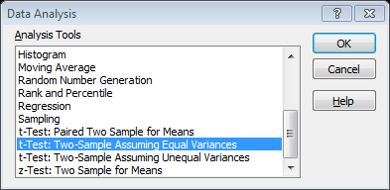
HYPOTHESIS TESTING T - TESTS
Independent Sample T Tests
Excel: Data \Data Analysis\ T-Test: Two Sample

Slide 54
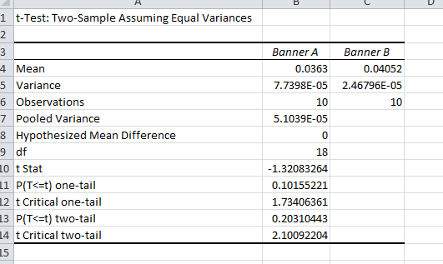
HYPOTHESIS TESTING T - TESTS

Slide 55
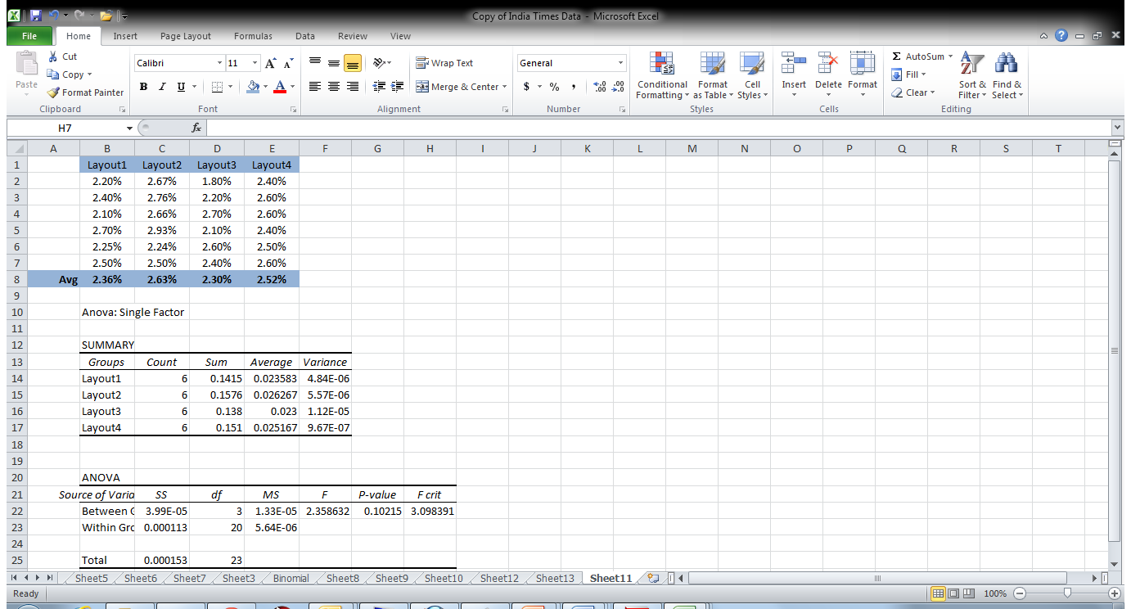
HYPOTHESIS TESTING Multiple sample tests
What if you have multiple samples?
Supposing you are checking effectiveness of click rate based on 4 different layouts
This is the data:

Slide 56
HYPOTHESIS TESTING ANOVA
Use ANOVA: SINGLE FACTOR in Data Analysis

Slide 57
HYPOTHESIS TESTING ANOVA
What If you change more than one factor at a time?
Layout, and Color
3 layouts, 2 Colors: 6 Combinations.
USE 2 FACTOR ANOVA

Slide 58
HYPOTHESIS TESTING ANOVA
ANOVA: Assumptions:
Can use when dependent variable is continuous, and independent variables are discrete
Requires samples to come from normally distributed populations
Sample Variances should not be very different
Samples should b independent

Slide 59
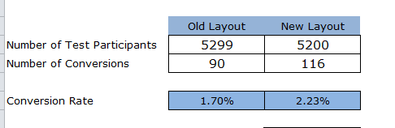
HYPOTHESIS TESTING Chi Square
Chi Square Tests are Non-Parametric Tests
Do not require underlying population to follow any distribution
Work on the basis of OBSERVED and EXPECTED frequencies
Used when you are dealing with COUNT or FREQUENCIES
Ex: A/B Testing
From Occam’s Razor blog : Kaushik Avinash

Slide 60
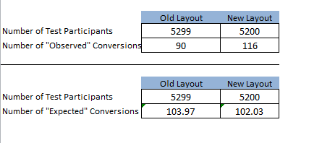
HYPOTHESIS TESTING Chi Square
What we have are “Observed” frequencies.
What would be “Expected” frequencies?
How?

Slide 61
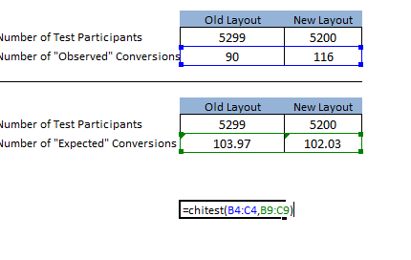
HYPOTHESIS TESTING Chi Square
Use CHI.TEST function in Excel
=CHITEST(observed_range, expected_range)
= 0.0515

Slide 62
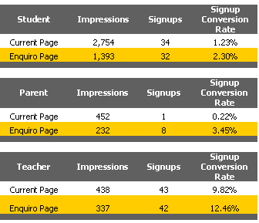
A/B Testing case study
http://mediative.com/case-studies/academy123-the-power-of-ab-testing.php
What would you conclude?

Slide 63
Regression models
What is a model?
Regression – Introduction
Simple Linear Regression
Multiple Linear Regression
Case Study – Second Hand Car Prices

Slide 64
Regression models
What is a model?
“A mathematical model is a description of a system using mathematical concepts and language.
A model may help to explain a system and to study the effects of different components, and to make predictions about behaviour.” ¹
Examples of models in business analytics:
Pricing Elasticity Models
Marketing Effectiveness
Fraud Detection
Customer Segmentation
Product Basket Analysis
1. Wikipedia.com

Slide 65
REGRESSION MODELS
A regression model looks at relationships between a continuous dependent variable and multiple independent variables that are hypothesized to have an influence on the dependent variable
Sales = f(? )
own price, competitor price, own promotions, competitor promotions, seasonality
Dependent Variable: Sales
Independent Variables: Own price, competitive price, promotions etc
A regression model estimates the mathematical form of function f.

Slide 66
LINEAR REGRESSION - OLS
No of fatalities in highway accidents and number of drivers in a state
Is there a relationship? What kind?

Slide 67
LINEAR REGRESSION - OLS
How many lines could be drawn through these points?
Which is the “best” line?

Slide 68
LINEAR REGRESSION - OLS
The best possible line is the line that is as close as possible to as many points as possible!
So if:
Fatalities = f(number of drivers)
We can write: fatalities = b0 + b1 * (Number of drivers) : Y = C + MX
The OLS regression method estimates b0 and b1 is such a way that those estimates will generate a line that is as close as possible to as many points as possible.

Slide 69
LINEAR REGRESSION - OLS
A regression equation is typically written as:
Y = β₀ + β₁X + e
If single X: Simple Linear Regression
If multiple X : Multiple Linear Regression
Y = β₀ + β1x₁ + β₂x₂ + β₃x₃ + β₄x₄ + e

Slide 70
LINEAR REGRESSION - OLS
When multiple factors influence dependent variable, a regression allows you to
compute the isolated impact of each factor
after taking into account the impact of other factors
Assumptions:
Random samples from an underlying population
Variable distributions are normal
Independent variables are not highly correlated with one another

Slide 71
LINEAR REGRESSION - OLS
How to run a regression
Excel:
Data Analysis: Regression
All variables should be in a continuous range
Target variable should be first or last column
Non numeric variables cannot be included

Slide 72
CASE STUDY OLS Marketing effectiveness
A manufacturer wants to understand how effective their marketing campaigns have been. The manufacturer sells via brick-and-mortar stores, but also via online stores ( a small share)
In terms of marketing, they have relied heavily on traditional vehicles: TV, in store discounts. Their marketing team has pushed for online campaigns, but management is not convinced of efficacy.
You have access to 2 years of weekly sales data, and details on promotions via multiple channels/vehicles.
How would you assess performance of marketing overall and specifically by channel?

Slide 73
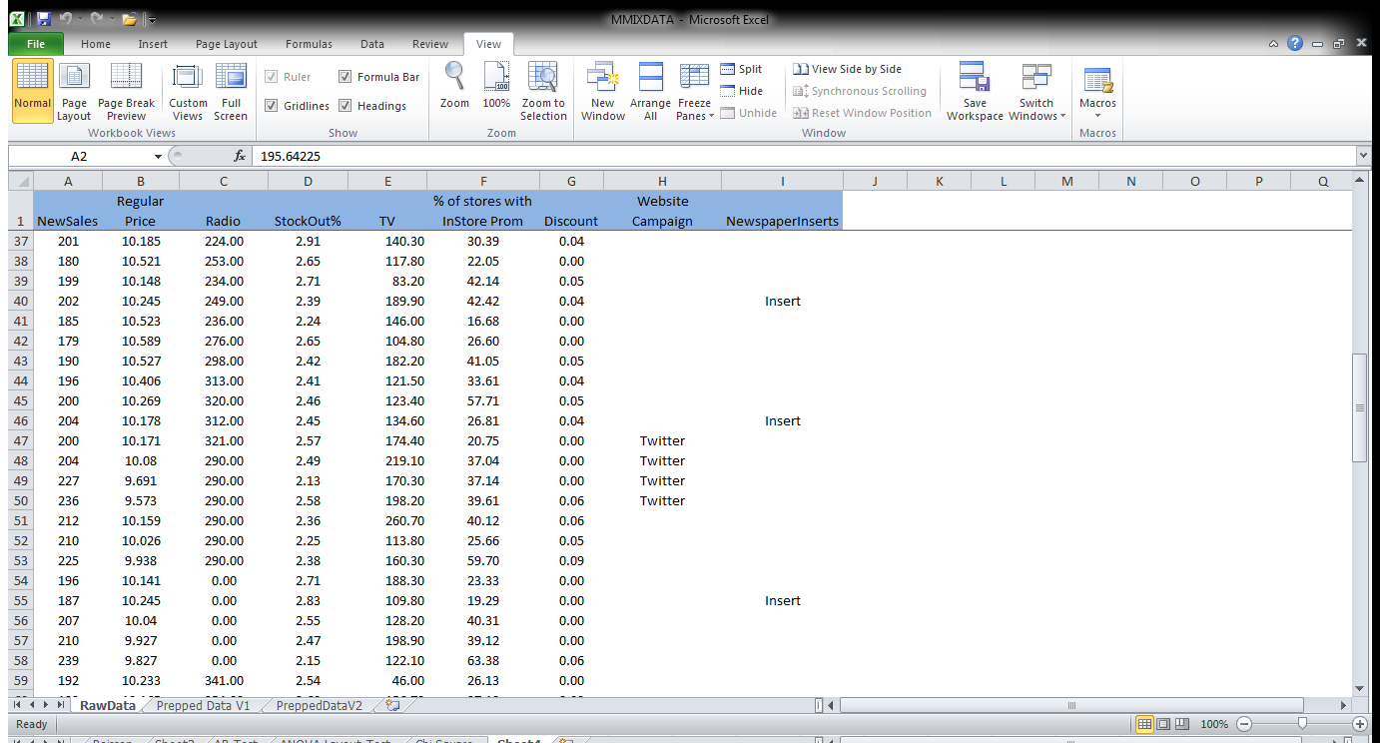
MARKETING EFFECTIVENESS CASE STUDY

Slide 74
MARKETING EFFECTIVENESS CASE STUDY
Convert Non-numeric data
How?
Dummy Variables:
Can only use total levels – 1 of dummy

Slide 75
MARKETING EFFECTIVENESS CASE STUDY
Interpreting output of a regression model
Sign
Significance
Overall fit (R Square)
Actual vs Predicted Plots

Slide 76

www.jigsawacademy.com

